Slide 1



STUDY BUDDY: A STUDENT’S BEST COMPANION
COURSE: ENTREPRENEURSHIP
CLASS: CC03
INSTRUCTORS: MR.TRẦN ANH TÚ & MR.PHẠM TIẾN MINH

Slide 2

I. Introduction
Study Buddy is an AI-integrated tutoring platform that matches students with private tutors efficiently. Target users include students, professionals, and parents — especially Gen Z, who value flexibility and tech-driven learning.

Slide 3

II. Company Overview
Vision & Mission
Vision: Become a leading AI-powered tutoring platform in Vietnam and globally within 5 years.
Mission: Deliver smart, personalized, and effective learning experiences.
Slogan: "Quick Tutor Matching - Smart Learning"

Slide 4

II. Company Overview
Company Name: Study Buddy
Representative Office: 268 Ly Thuong Kiet, Ward 14, District 10, HCMC
Founded: 2025
Status: Development phase with 5 employees
Initial Capital: 5,000,000,000 VND

Slide 5
II. Company Overview

Slide 6

II. Company Overview
Strengths & Weaknesses
Strengths:
Advanced AI for tutor matching
Intuitive interface with scheduling, payment, and feedback
Weaknesses:
High cost of AI development
Strong competition from established platforms

Slide 7
II. Company Overview
Development Goals
Short-Term (Year 1):
Launch platform and attract users
Improve matching algorithms
Partner with schools and institutions

Slide 8
II. Company Overview
Development Goals
Mid-Term (Years 2–3):
Expand regionally
Add performance tracking and personalized recommendations
Introduce subscription and premium features

Slide 9
II. Company Overview
Development Goals
Long-Term (Years 4–5):
Enter global markets
Build an AI-powered educational ecosystem
Secure additional funding

Slide 10
II. Company Overview
Exit Strategy
Sell or merge with strategic partner if growth is slow
Seek additional investors if potential is strong
Adjust business model for better cost-efficiency and focus

Slide 11






III. TECHNOLOGY SECTION
Technology Highlights
Recommendation Engine
OCR and Image Processing
Uses user profiling, hybrid matching algorithms, contextual data
Tesseract and custom CNN models
AI-Driven Question Answering
AI-Powered Study Plan Generator
Enhances user interaction
Provides personalized study plans

Slide 12

Integration, Scalability, and Security
Modular and Microservices Architecture
Cloud-Native Infrastructure
Data Security and Compliance
Robust API Management
Simplifies maintenance and updates, separately scale individual components
High availability, auto-scaling, and disaster recovery capabilities
Industry-standard security protocols, End-to-end encryption, secure authentication mechanisms, ...
Ensures secure and efficient communication between microservices, third party systems and mobile/web interfaces.

Slide 13
IV. INDUSTRY ANALYSIS
Medium due to barriers like brand recognition and AI development costs
Threat of New Entrants
Bargaining Power of Suppliers
Bargaining Power of Buyers
Threat of Substitutes
Competitive Rivalry
Porter's Five Forces Model
High due to existing strong competitors
Medium, skilled tutors are limited, giving them negotiations
High, with other online platforms and traditional tutoring services
High due to numerous alternatives

Slide 14
Trends and Growth in the Tutoring Industry
Personalized Learning
Market Growth
Challenges
Growth Potential
Impact of COVID-19
Tailored education for individual needs.
Rapid expansion to $6.01 billion by 2025.
Competition, economic risks, and tech challenges.
STEM demand, tech advancements, and Asia-Pacific expansion.
Accelerated online learning adoption.

Slide 15
V. MARKET ANALYSIS
Growth Drivers
Increasing demand for personalized learning
Cultural emphasis on education
Market Trends
Urban-rural divide, with urban households spending more
Opportunities
Developing affordable solutions for rural areas
Integrating technology for personalized learning
Growth Rate
Technological advancements
AI-driven platforms enhancing tutoring experiences.
Over 10% annual growth in the private education market
Driven by parental investment in education.

Slide 16
VI. TARGET MARKET
6.1 Market
As long as individuals are eager to learn and have access to the Internet, they are our potential customers and can effectively utilize our application to further enhance their skills.

Slide 17
6.2 Customer Segments
Customer Segment | Demographics | Psychographics | Needs
Students | All ages, levels of educations, and fields of study | Struggled to comprehend a concept, interested in self-development | Comprehensive course, step by step tutorial, one on one class, etc.
Job Seekers | Newly graduated, unemployed, changing workplace | Seeking for career opportunities, a better work-life balance | Courses on soft skills, writing resume, interview preparation, etc.
Working Professionals | Professionals from all industries, with different levels of experience | Aiming to improve skills, seeking career - payroll advancement | Certificated course, flexible schedule, microlearning, etc.
Retirees & Hobbyists | Those who have free time and want to learn new things | Interested in personal enrichment, hobby, or lifelong learning | Courses like art and craft, teaching language, computer skills, etc.
Notes:
What is Demographic and Psychographic??
Think of demographics as the basic facts about a group of people. It answers questions like:
How old are they?
Are they male or female?
Where do they live?
What’s their income level?
What’s their education or job?
So, for example, if you're targeting women aged 25–40 who live in cities and have a college degree, that’s demographic info.
Psychographics go deeper—they’re about what people care about, how they think, and what motivates them. It covers things like:
What are their interests and hobbies?
What are their values and beliefs?
What kind of lifestyle do they live?
What are their goals or challenges?
For example, someone who values sustainability, loves fitness, and cares about self-growth—that’s psychographic info.
What is microlearning??
Microlearning is learning in small chunks, get infomation in short bursts like quick videos, short articles, etc. or interactive quizzes.

Slide 18
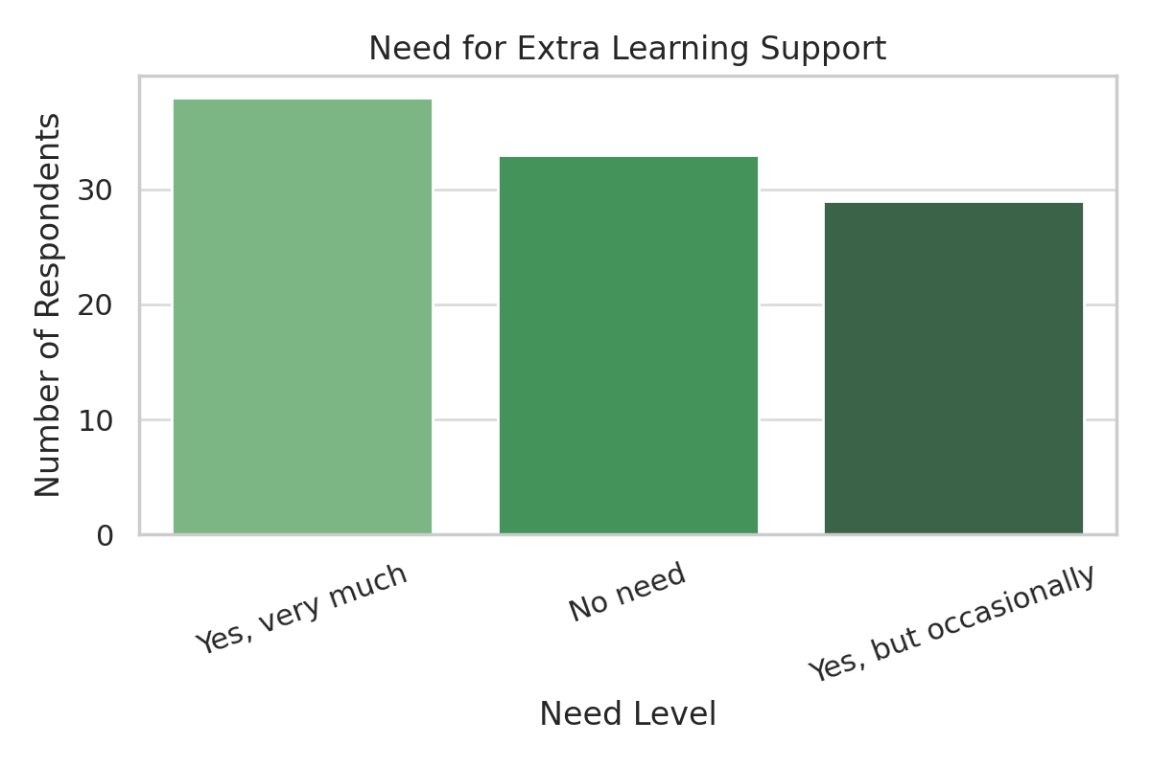
Notes:
What is Demographic and Psychographic??
Think of demographics as the basic facts about a group of people. It answers questions like:
How old are they?
Are they male or female?
Where do they live?
What’s their income level?
What’s their education or job?
So, for example, if you're targeting women aged 25–40 who live in cities and have a college degree, that’s demographic info.
Psychographics go deeper—they’re about what people care about, how they think, and what motivates them. It covers things like:
What are their interests and hobbies?
What are their values and beliefs?
What kind of lifestyle do they live?
What are their goals or challenges?
For example, someone who values sustainability, loves fitness, and cares about self-growth—that’s psychographic info.
What is microlearning??
Microlearning is learning in small chunks, get infomation in short bursts like quick videos, short articles, etc. or interactive quizzes.

Slide 19
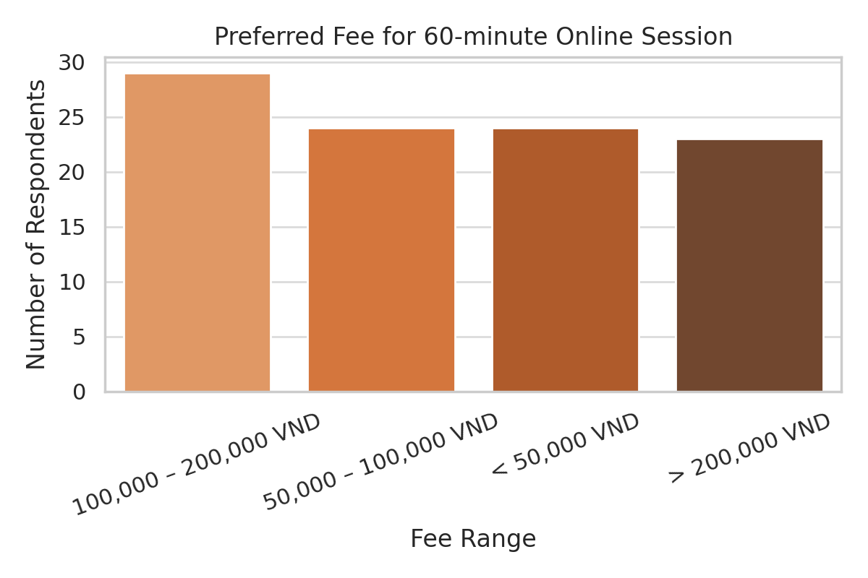
Notes:
What is Demographic and Psychographic??
Think of demographics as the basic facts about a group of people. It answers questions like:
How old are they?
Are they male or female?
Where do they live?
What’s their income level?
What’s their education or job?
So, for example, if you're targeting women aged 25–40 who live in cities and have a college degree, that’s demographic info.
Psychographics go deeper—they’re about what people care about, how they think, and what motivates them. It covers things like:
What are their interests and hobbies?
What are their values and beliefs?
What kind of lifestyle do they live?
What are their goals or challenges?
For example, someone who values sustainability, loves fitness, and cares about self-growth—that’s psychographic info.
What is microlearning??
Microlearning is learning in small chunks, get infomation in short bursts like quick videos, short articles, etc. or interactive quizzes.

Slide 20
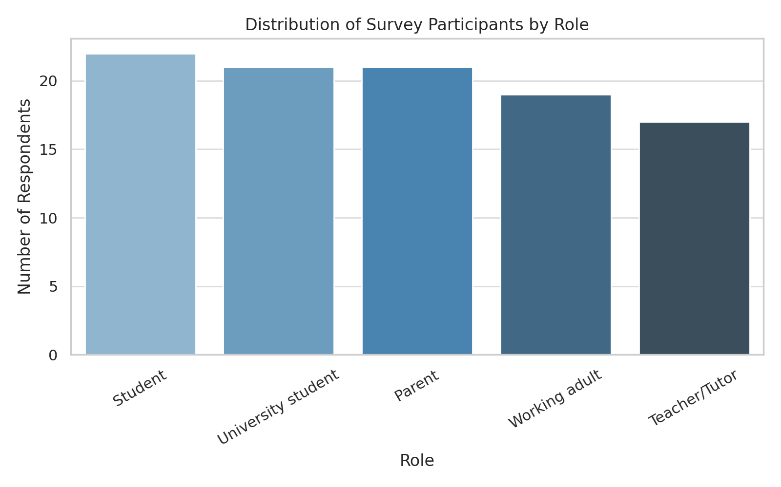
Notes:
What is Demographic and Psychographic??
Think of demographics as the basic facts about a group of people. It answers questions like:
How old are they?
Are they male or female?
Where do they live?
What’s their income level?
What’s their education or job?
So, for example, if you're targeting women aged 25–40 who live in cities and have a college degree, that’s demographic info.
Psychographics go deeper—they’re about what people care about, how they think, and what motivates them. It covers things like:
What are their interests and hobbies?
What are their values and beliefs?
What kind of lifestyle do they live?
What are their goals or challenges?
For example, someone who values sustainability, loves fitness, and cares about self-growth—that’s psychographic info.
What is microlearning??
Microlearning is learning in small chunks, get infomation in short bursts like quick videos, short articles, etc. or interactive quizzes.

Slide 21
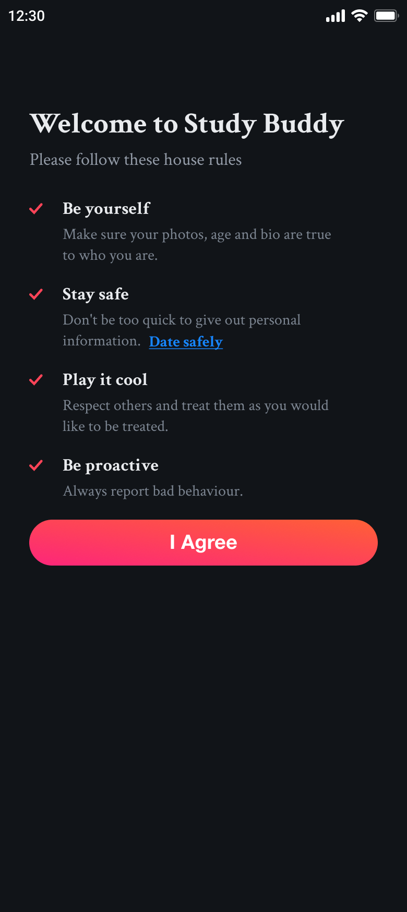
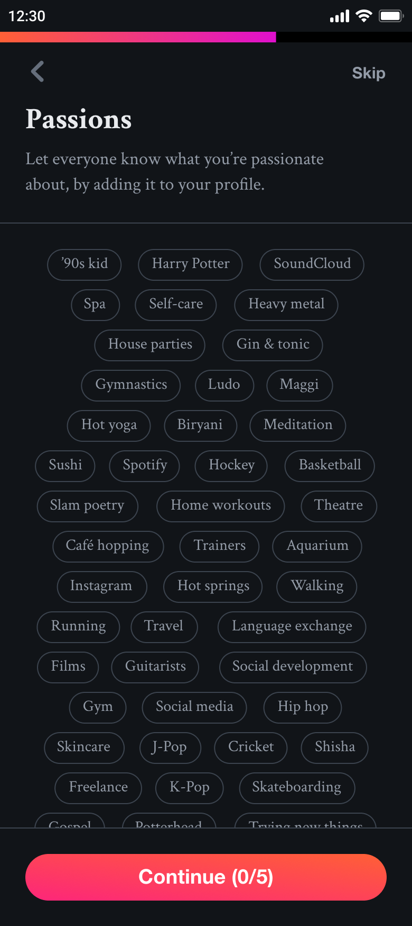
7.1 Product
VII. Sales and Marketing
Target Audience: learners of all ages seeking academic support, career advancement, or hobby fulfillment.
Our Goals: to provide a simple, intuitive, and user-friendly application for everyone.
Key Features: Easy navigation, accessible design, and comprehensive educational resources

Slide 22
7.2 Sales Strategy
Sales Model
Trial: a freemium account with limited access
Subscription: either buy course individually or monthly-yearly payment for full access of the AI Solving Assistant
Corporate: bulk purchases with chosen courses for a discounted price
Special Offer Programme
Coupon Codes: offer coupons during promotions or festive seasons, such as Black Friday
Students Discounts: more affordable and encouraging learning
Group Plans: offering discount when registers as a group of 4 or more
Loyalty Programme: special sales for long-term subscribers and frequent buyers
Referral Bonuses: tempting discounts for user who refer new customers to the platform
Notes:
What is Demographic and Psychographic?? Demographic:
Think of demographics as the basic facts about a group of people. It answers questions like:
How old are they?
Are they male or female?
Where do they live?
What’s their income level?
What’s their education or job?
So, for example, if you're targeting women aged 25–40 who live in cities and have a college degree, that’s demographic info.
Psychographic:
Psychographics go deeper—they’re about what people care about, how they think, and what motivates them. It covers things like:
What are their interests and hobbies?
What are their values and beliefs?
What kind of lifestyle do they live?
What are their goals or challenges?
For example, someone who values sustainability, loves fitness, and cares about self-growth—that’s psychographic info.

Slide 23
7.3 Marketing Strategy
New Customer Acquisition: free trial after register with first time discount.
Referral Programmes: word-of-mouth marketing
Social Media Marketing: outlets such as Facebook, LinkedIn, Google Ads, etc.
Influencer Partnerships: collaborating with educational figures to promote since their main audiences are interested in learning.
Content Marketing: having free courses, live classes, and writing articles on the Internet.

Slide 24








7.4 Distribution Strategy
Split into 2 stages:
Stage 1: mobile app on both IOS/IpadOS and Android platforms via App Store and Google Play Store.
Stage 2: extended to website, available on Google Chrome, Firefox, Safari, etc.
Notes:
What is Demographic and Psychographic?? Demographic:
Think of demographics as the basic facts about a group of people. It answers questions like:
How old are they?
Are they male or female?
Where do they live?
What’s their income level?
What’s their education or job?
So, for example, if you're targeting women aged 25–40 who live in cities and have a college degree, that’s demographic info.
Psychographic:
Psychographics go deeper—they’re about what people care about, how they think, and what motivates them. It covers things like:
What are their interests and hobbies?
What are their values and beliefs?
What kind of lifestyle do they live?
What are their goals or challenges?
For example, someone who values sustainability, loves fitness, and cares about self-growth—that’s psychographic info.

Slide 25
7.5 Marketing Strategy
Category | Budget (VND) | Percentage | Note
Advertising | 210,000,000 | 42% | Through Google Ads, Facebook Ad, etc.
App Store Optimization (ASO) | 40,000,000 | 8% | Improves app visibility and downloads
Content Marketing | 50,000,000 | 10% | Improve Search Engine Optimization (SEO) through blog, article, etc.
Influencer Partnerships | 60,000,000 | 12% | Collabs with well-known content creators
Event Participation | 65,000,000 | 13% | Builds direct connections with customers; useful for networking
Market Research and Analysist | 55,000,000 | 11% | Collects data and refines strategy
Miscellaneous | 20,000,000 | 4% | Covers unexpected opportunities or experimental ideas.
Total | 500,000,000 | 100%

Slide 26
Competitor Analysis - Global
VIII. COMPETITOR ANALYSIS
The global EdTech market is growing thanks to AI, machine learning, and digital technologies.
Major competitors: Coursera, Udemy, Khan Academy, Byju's, VIPKid.
Strengths: Strong partnerships, reputable certificates, advanced technology.
Weaknesses: High cost, lack of personalization, culturally unfit content.

Slide 27
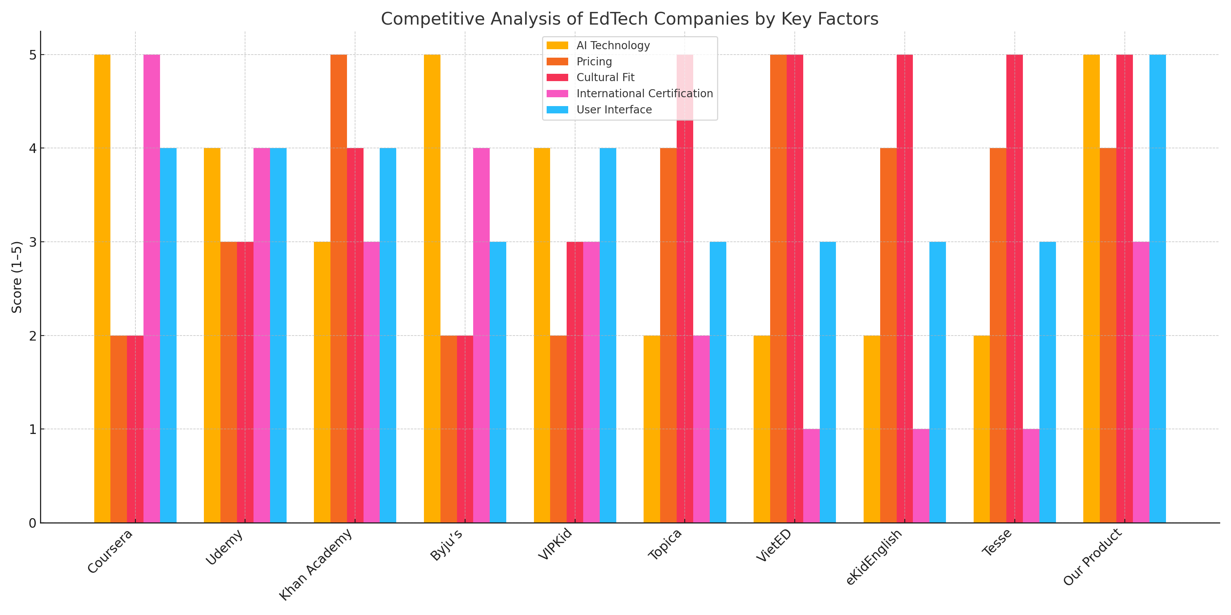
Domestic Competitors & Competitive Advantages
VIII. COMPETITOR ANALYSIS
Local competitors: Topica, VietED, eKidEnglish, Tesse,…..
Strengths: Cultural understanding, affordable pricing, Vietnamese content.
Weaknesses: Weak AI tech, limited content, lack of international certificates.
Our advantages: Personalized AI, user-friendly UI, competitive pricing, educational partnerships.

Slide 28

IX. Management Team & Structure
The management team drives direction, innovation, and operations:
CEO - Strategic planning and executive decisions.
CTO - Technical leadership, AI development.
CFO - Financial management and investments.
CMO - Marketing strategy and brand development.
COO - Daily operations and process optimization.
PM, Head of AI, Engineering, and Support - Product development, tech leadership, customer support.
CEO
├── CTO | CFO | CMO | COO
├── PM | Head of AI | Head of Engineering | CS Lead

Slide 29
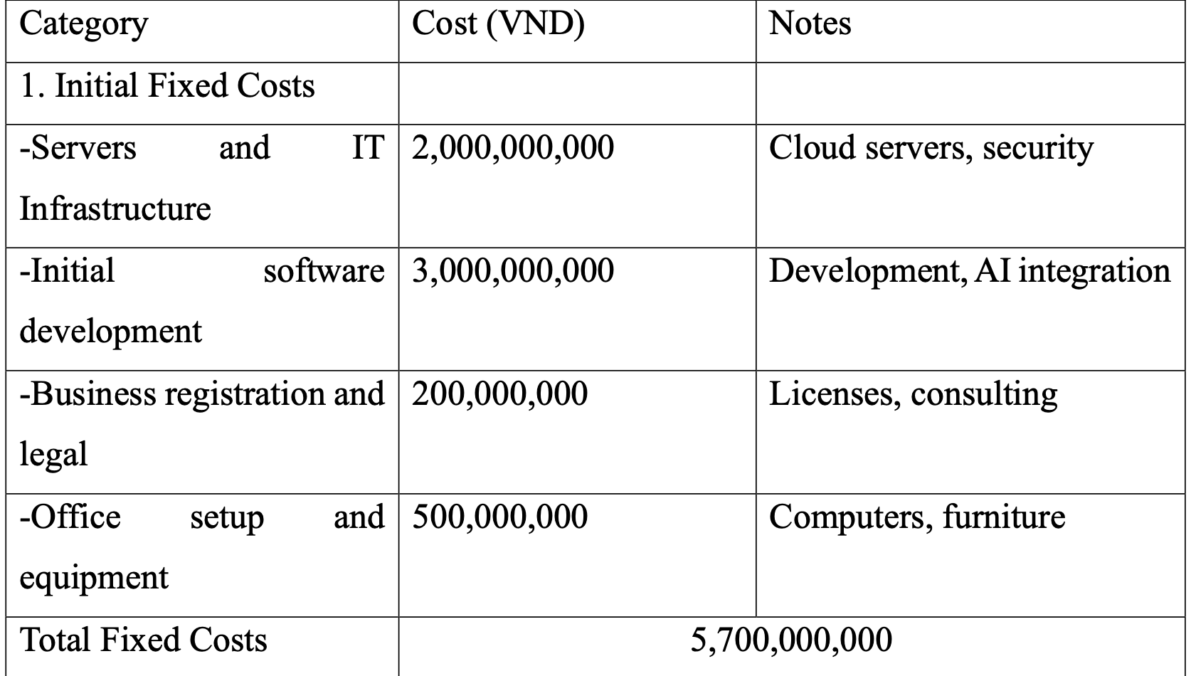
X. Financial analysis

Slide 30
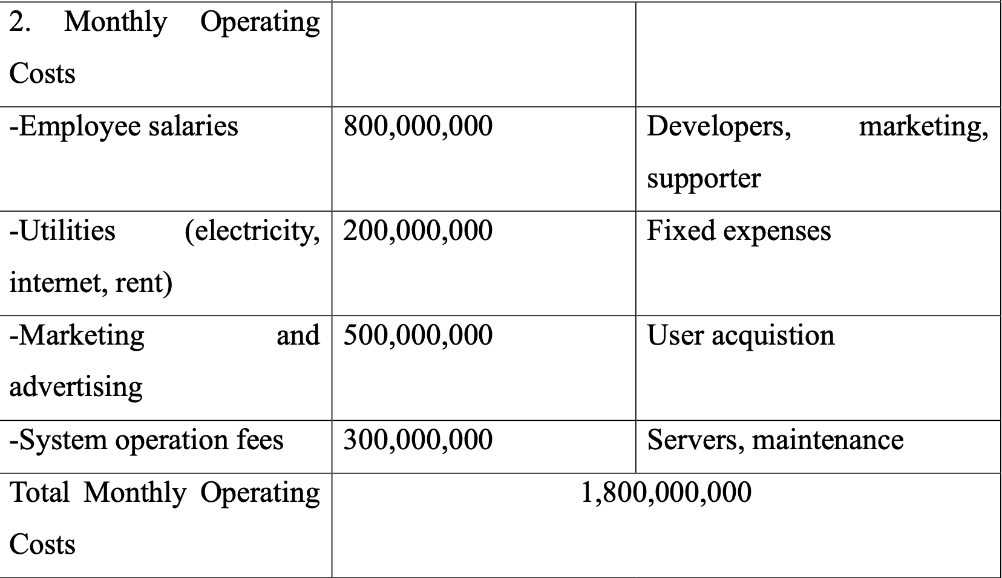

Slide 31
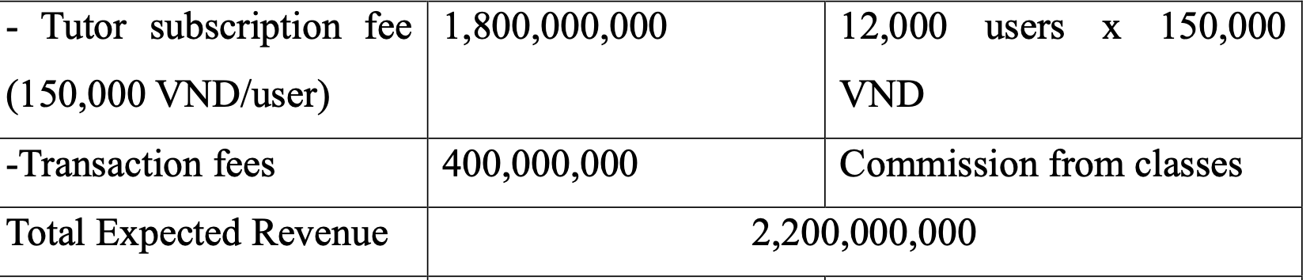
3. Estimated Monthly Revenue

Slide 32
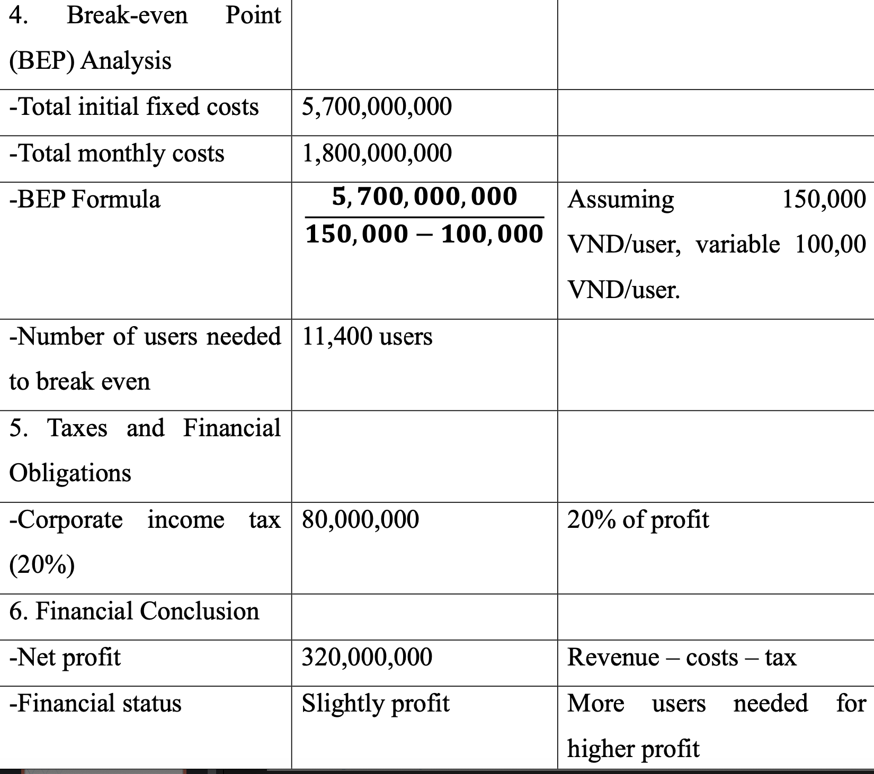

Slide 33
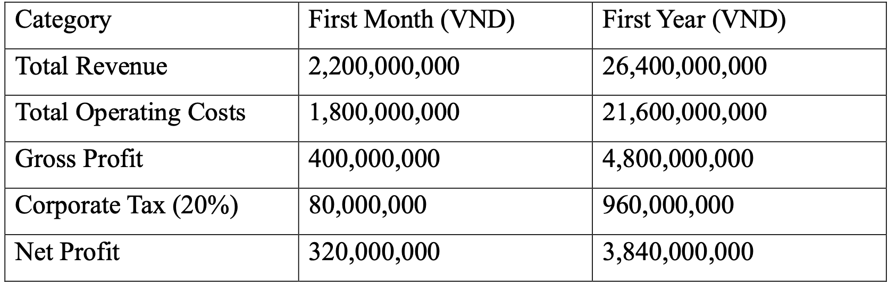
Profit Summary for the First Month and Year

Slide 34
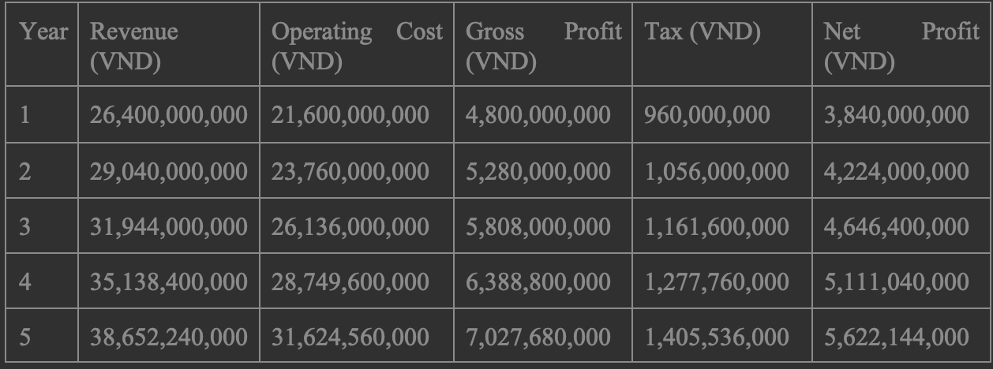
Cash Flow Analysis for 5 Years

Slide 35
Evaluation & Insights
Positive Aspects:
Sustainable Growth: Revenue and profit increase steadily by 10% annually, reaching 5.6 billion VND in net profit by Year 5.
Strong Profit Margins: Maintains a healthy ~14–15% net margin after tax.
Healthy Financials: Break-even at 114,000 users but already profitable with 12,000 users/month.
Risks & Recommendations:
Scalability & Competition: Innovate constantly; consider AI features or strategic partnerships.
Rising Costs: Control operating expenses (cloud, salaries, marketing).
User Growth Dependency: Focus on retention and referrals to support growth.
Conclusion:
The business is financially stable with steady growth.
Diversifying revenue beyond subscriptions will boost long-term profitability.

Slide 36
Exit Strategy Overview
Why It's Important:
Ensures long-term planning & investor clarity
Prepares for market changes & aligns with financial goals
Maximizes valuation for AI-powered EdTech startups
Sell the Company (Acquisition)
Suitable for high-growth EdTech platforms
Potential buyers: Coursera, Google, Duolingo, investors
Exit valuation: 3–5× annual revenue
Key: Grow users, protect IP, ensure smooth post-sale transition
Merge with Larger Company
Ensures sustained growth & tech integration
Ideal partners: Khan Academy, Microsoft AI, local EdTech firms
Retain influence & expand reach
Key: Synergy, founder involvement, investor protection
Conclusion:
Sell for quick financial return
Merge for long-term innovation
Focus now: Scale fast, build strong AI, grow loyal user base

Slide 37
The End
Thank for your Listening

